Slide 1

Appalachian Trail – Thru Hike
Mount Katahdin is Calling!
Do you have what it takes to make it all the way?

Slide 2
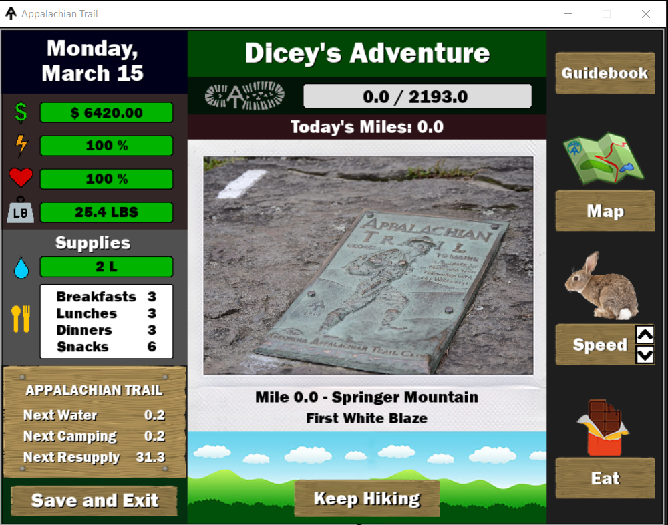
An Adventure Game
The Player will attempt to walk 2193 miles from Georgia to Maine.
During game play, the user will have to manage resources in order to maintain energy and health.
The user will have to manage the funds chosen at the beginning of the game in order to ensure the money will last until Katahdin in Maine is reached.
Random events will affect the users food supply, gear, health and energy

Slide 3
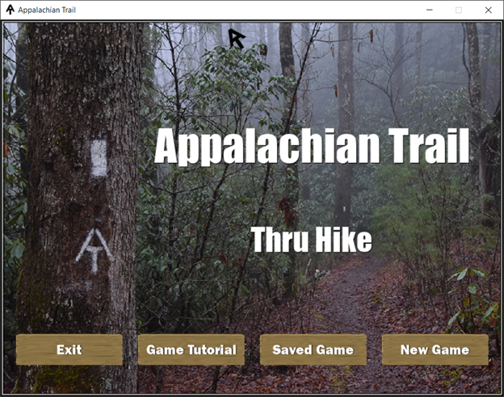
Game Start Menu
Allows the user to:
The Start Menu allows the user to play a new game
Retrieve a saved game
View a tutorial describing the information about the game

Slide 4
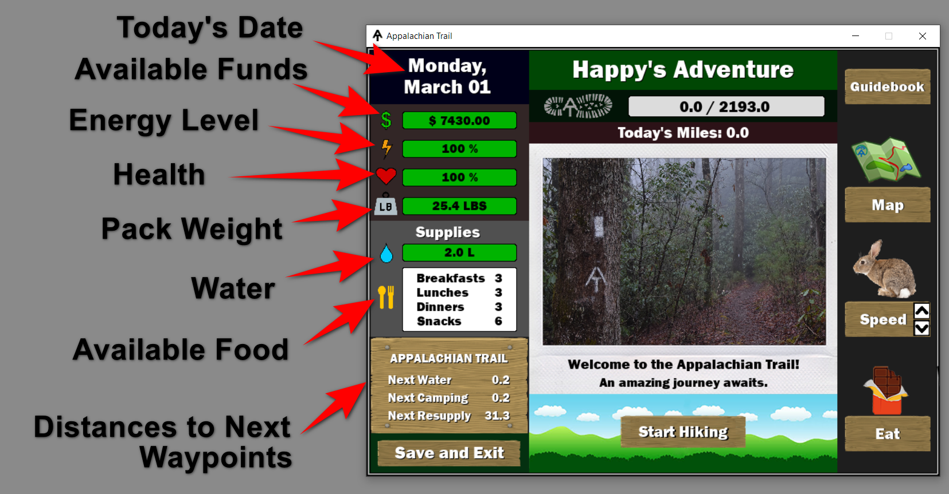
Game Tutorial
Describes the actions of the game.

Slide 5
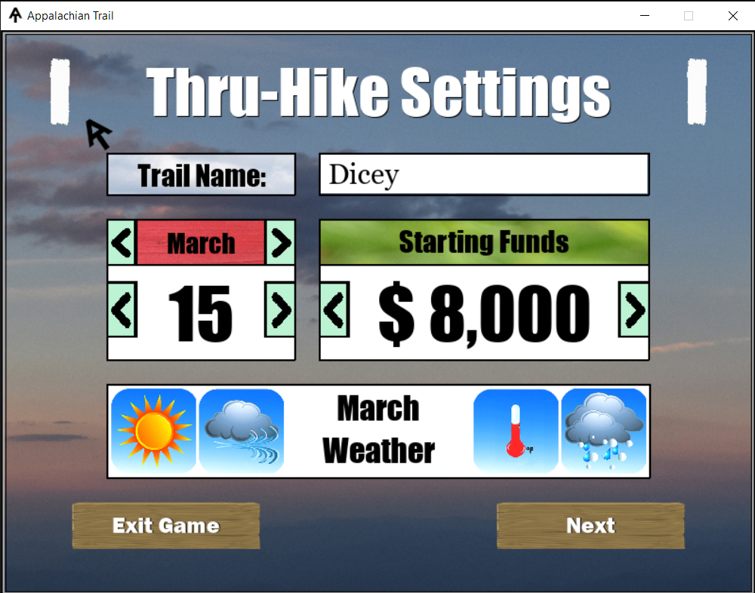
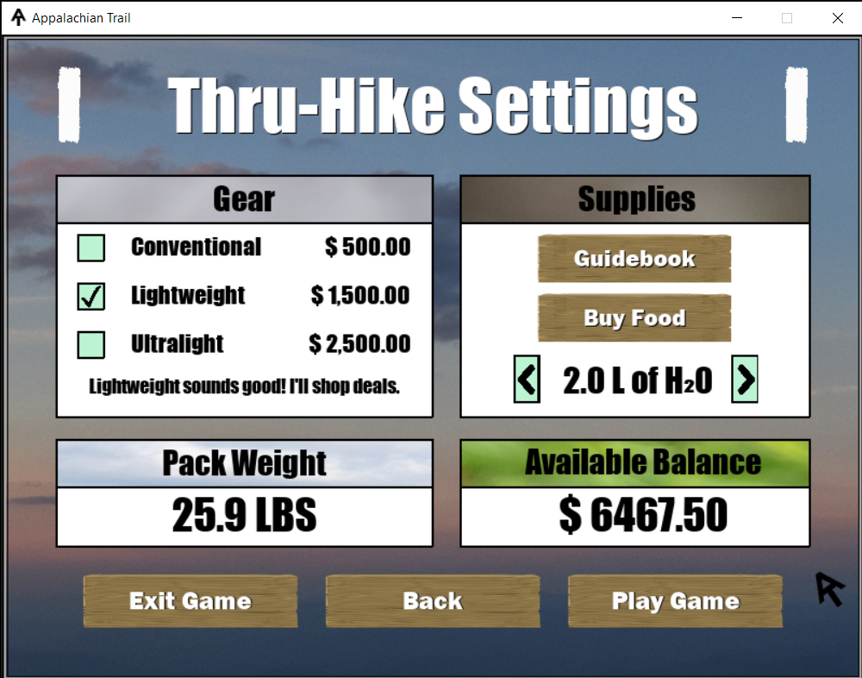
Player Menu
Allows the player to choose gear, purchase food, etc.

Slide 6
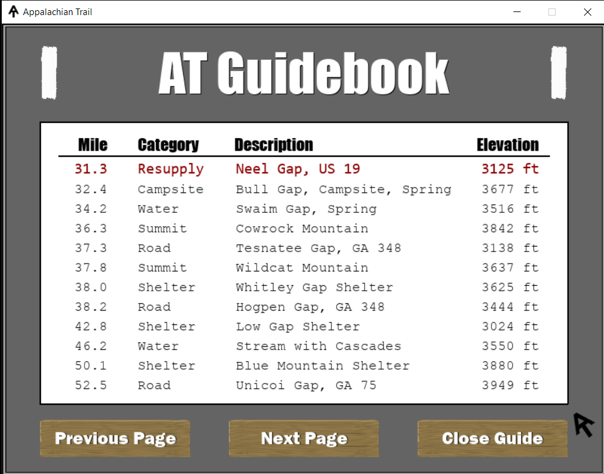
AT Guidebook
Lists all the waypoints on the trail.
The list allows the player to determine the amount
of food needed until the next resupply point.

Slide 7
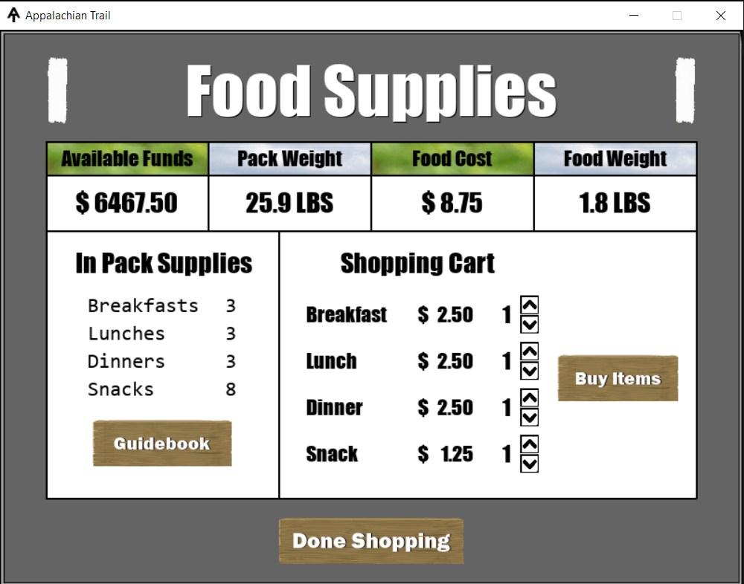
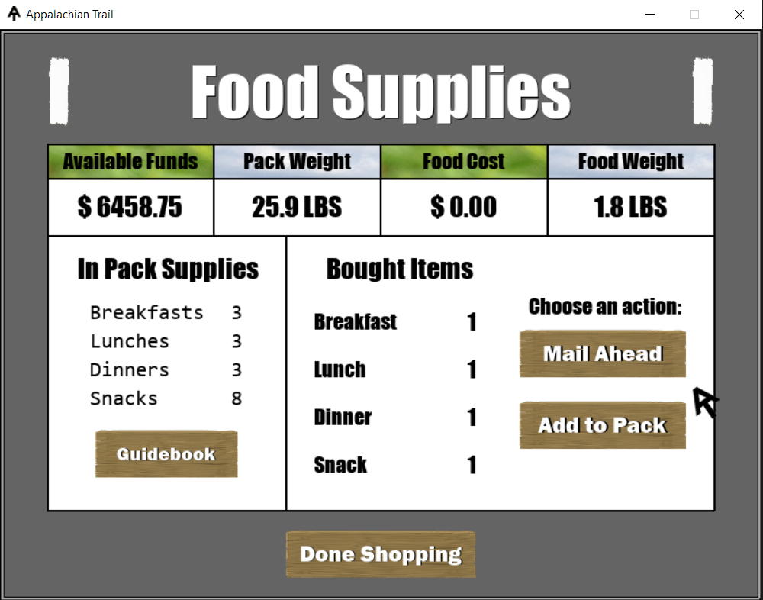
Food Supplies
The player can purchase food. The food can either be
added it to their pack or mailed it ahead

Slide 8
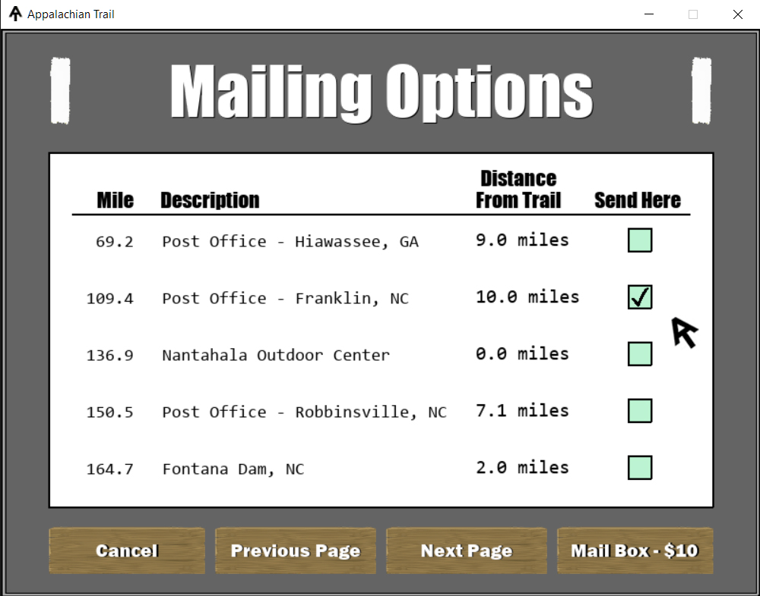
Mailing Options
Allows the user to mail the food ahead
to be picked up when the town is reached.

Slide 9
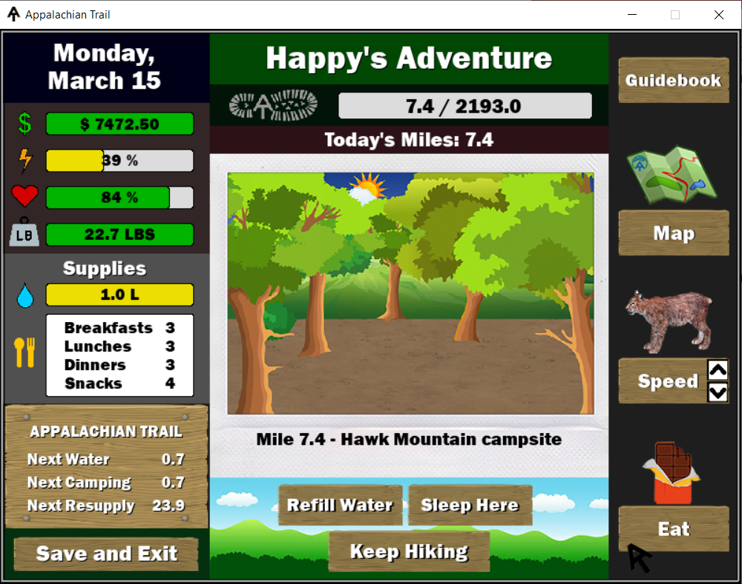
Game Play
During the game, the player’s energy and amount of water
they are carrying decreases.
Some waypoints allow the user to sleep and refill water.
Town resupply waypoints allow to user to go to town to resupply food, gear and health.

Slide 10
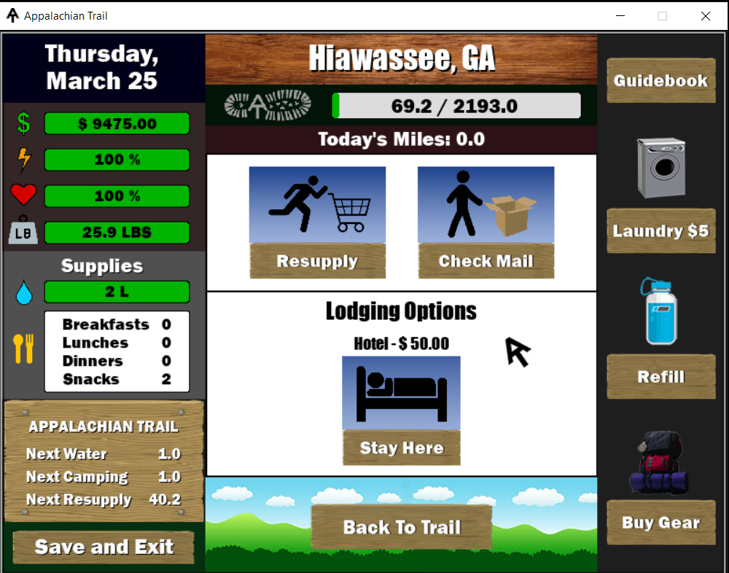
In Town
The player can resupply food, sleep at available lodging, and visit the gear shop. Laundry is also available in town.

Slide 11
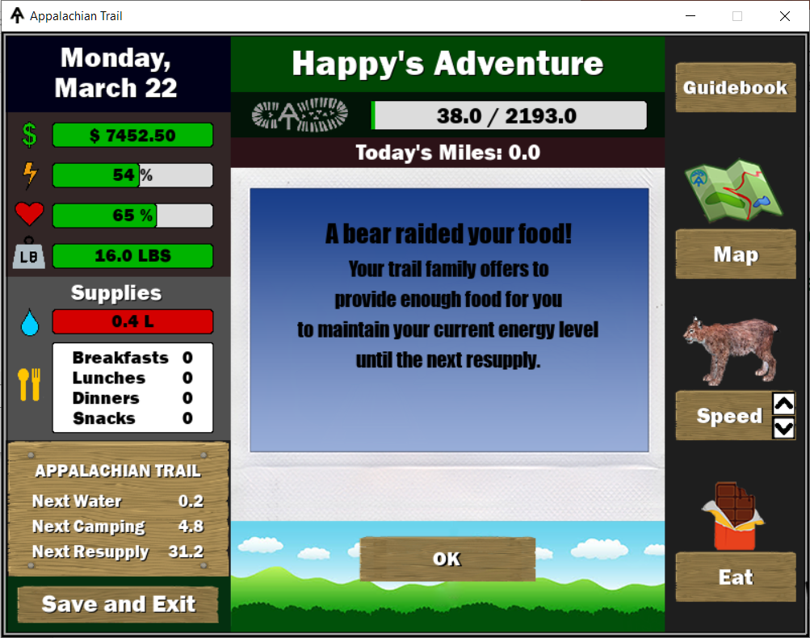
Random Events
During the game random events will affect the player’s
health, energy, and gear.

Slide 12
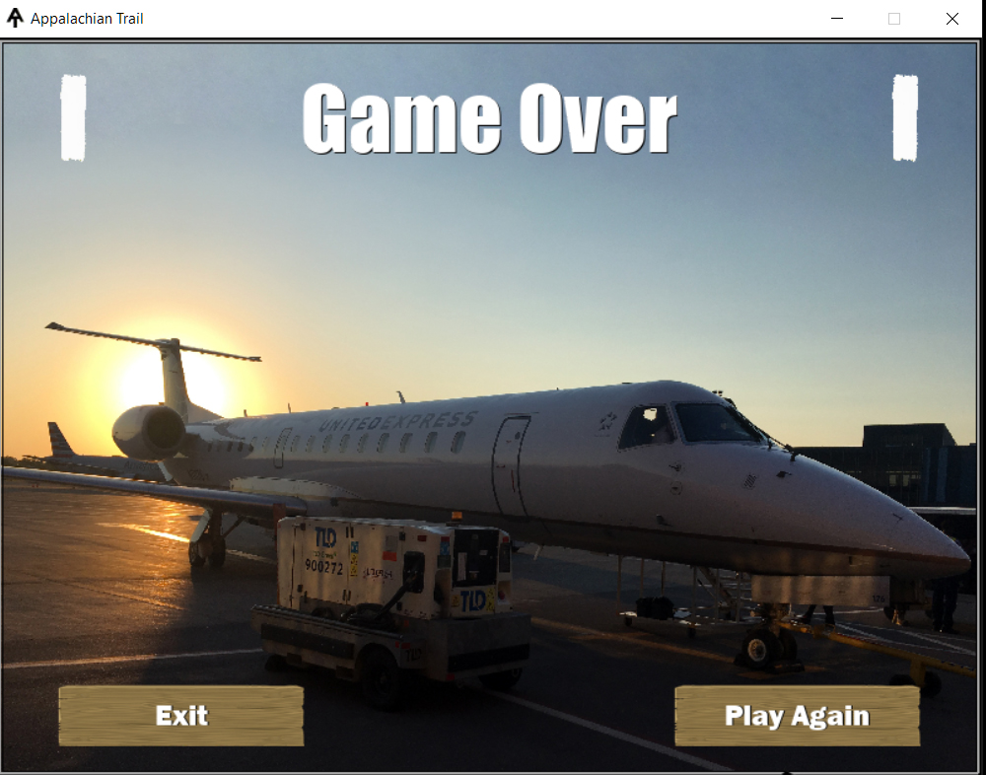
Game Win – Game Loss
In order to win the game, the player must reach
Mount Katahdin at mile 2193 by October 15. If the
player runs out of health, energy or funds, the game ends.

